Slide 1
Advanced Algorithms Week 12
Gorkem Kar
Notes:
Backtracking II

Slide 2

Contents
Review
Intractability
Input size revisited
The general problem categories
The theory of NP
Handling NP-hard problems
Christofides’ Algorithm

Slide 3
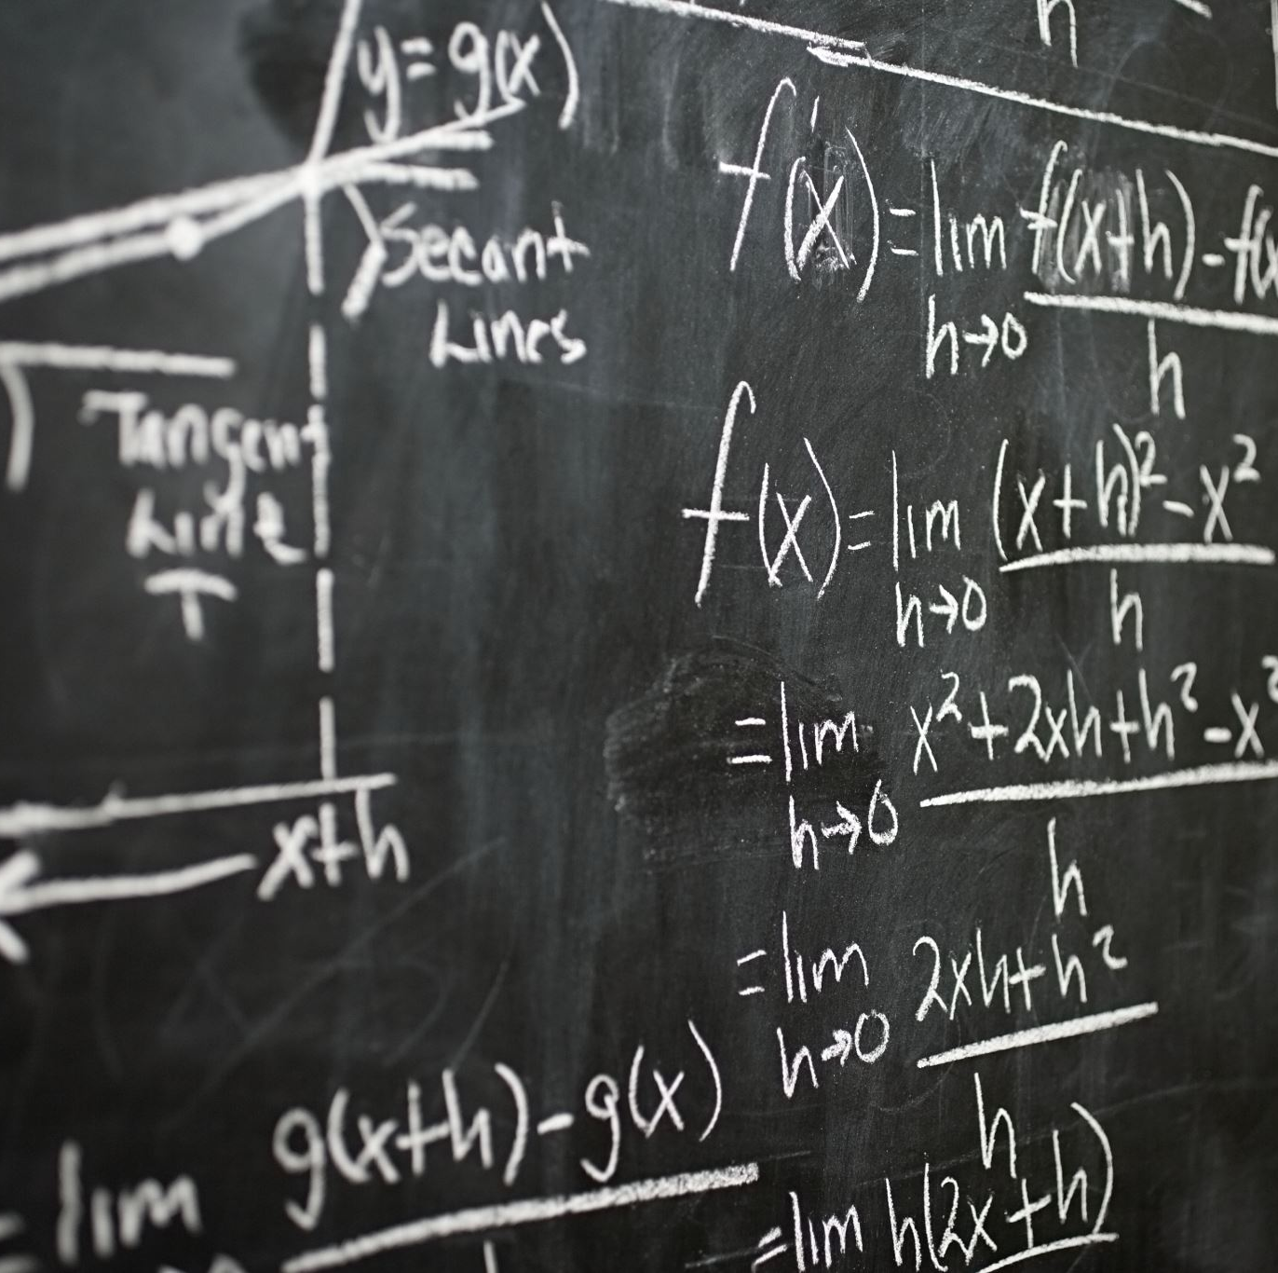
Intractability
Problems for which no efficient solving algorithm is known
What is efficiency?
If the solution takes exponential running time
Intractable problems
If the solution takes polynomial running time
Tractable problems
Notes:
How to decide it’s exponential or polynomial?

Slide 4
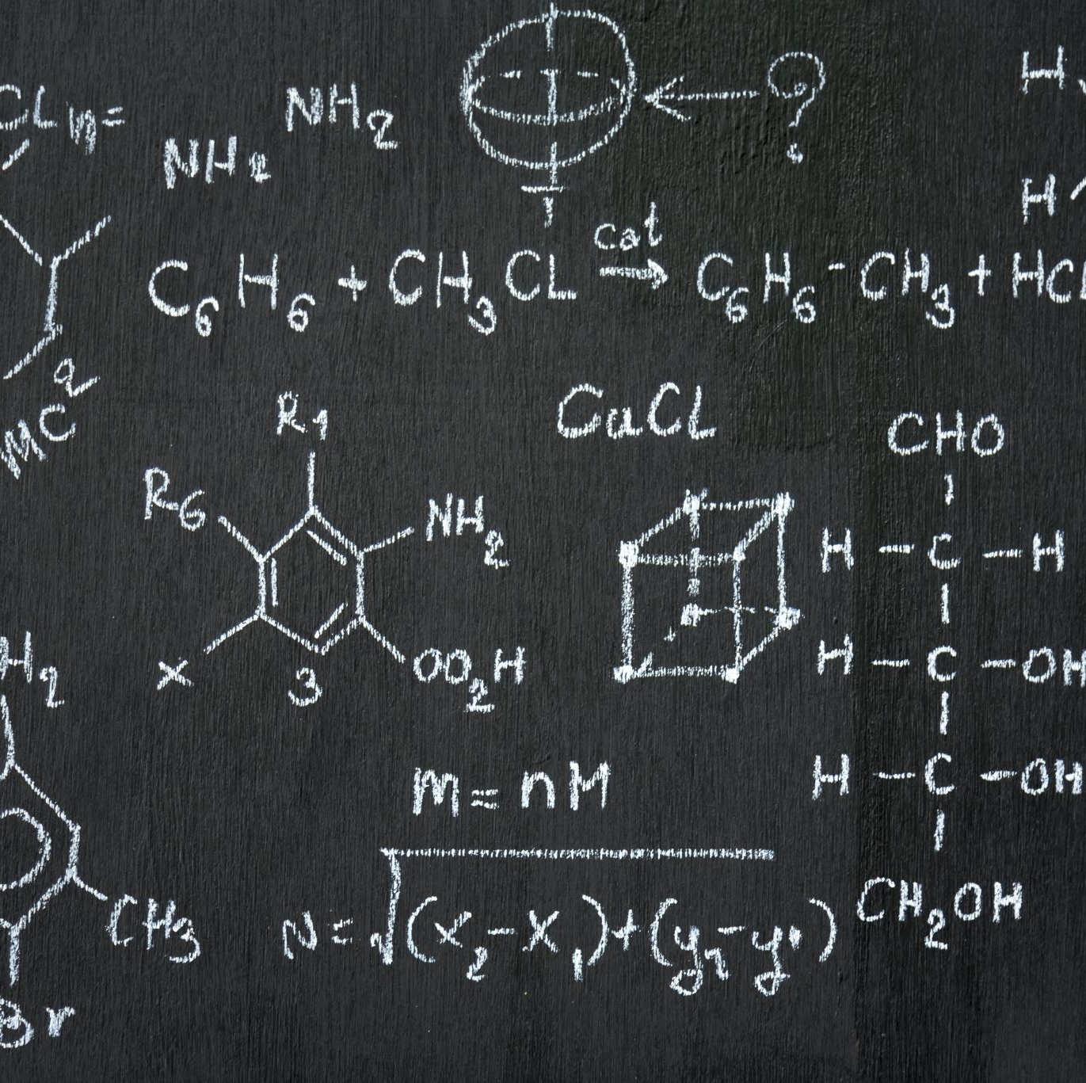
Polynomial or Exponential
O(n)
O(logn)
O(n²)
O(1.000001^{n})
O(2^{n}logn)
O(n¹⁰⁰⁰)
O(2^{logn})
O(1^{n})
Notes:
Polynomial
Polynomial
Polynomial
Exponential
Exponential
Polynomial
Polynomial
Polynomial

Slide 5
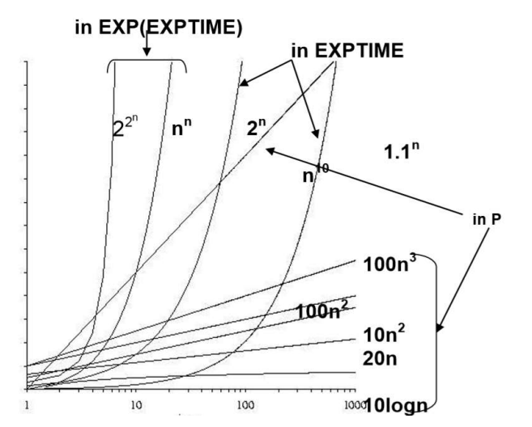
The Comparison
Notes:
The reference: https://www.jadmatta.com/data/Tractable%20and%20Intractable%20Problems.pdf

Slide 6

Input Size Revisited
The amount of data an algorithm needs to process
Large input sizes generally increase the computational complexity
Sorting a list of numbers:
O(nlogn)

Slide 7

The General Problem Categories
Easy problems (P)
Problems solvable in polynomial time
Examples
Sorting algorithms, basic arithmetic operations
O(n^{k}) where k is constant
Hard problems (NP)
Problems verifiable in polynomial time but it is unknown whether they can be solved in polynomial time
Verifiable in O(n^{k}) for constant k
Hamiltonian Cycle Problem
We can verify there has to be a Hamiltonian Cycle,
But finding that cycle can take exponential time
Notes:
Dirac’s Theorem
Ore’s Theorem
Can you give me another NP example?
- Sudoku!

Slide 8
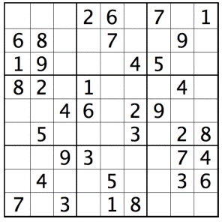
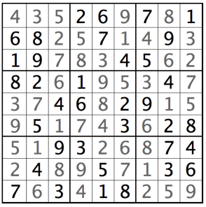
Sudoku

Slide 9
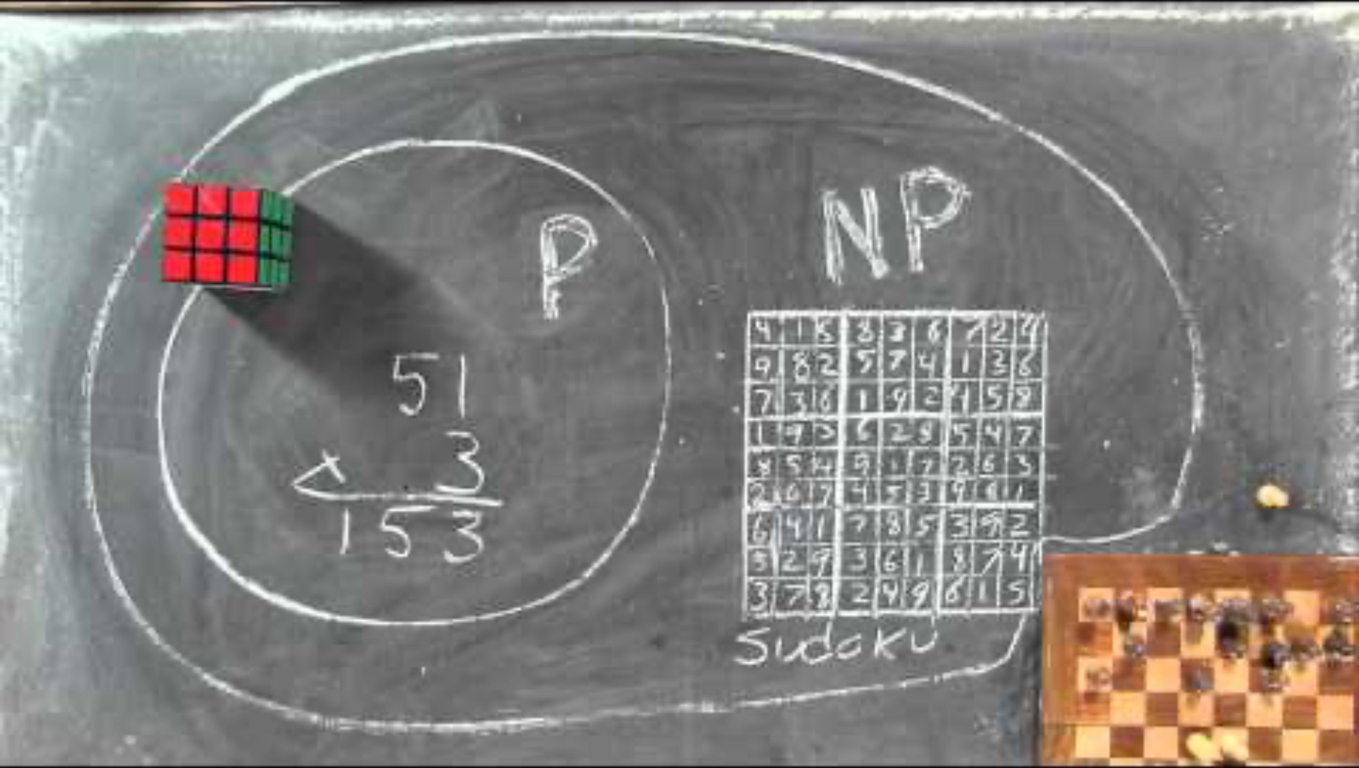
One million dollars?
Notes:
https://www.youtube.com/watch?v=YX40hbAHx3s

Slide 10
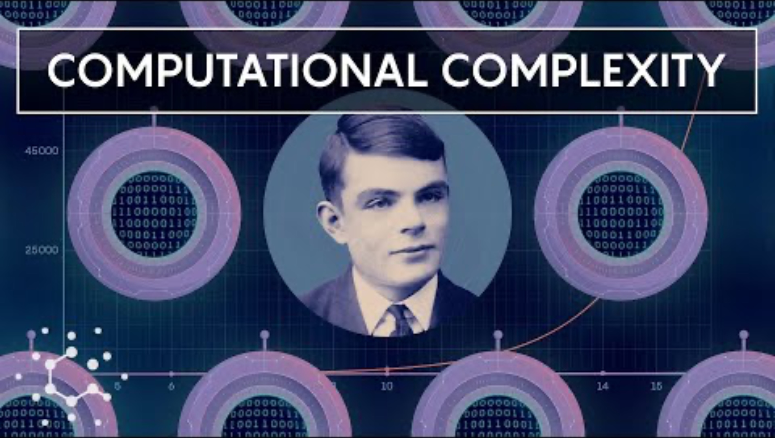
The Theory of NP

Slide 11
Handling NP-Hard Problems
Approximation algorithms
Find near-optimal solutions
Heuristics
Practical methods for finding good enough solutions
Special Cases
Restricting problem instances to make them more manageable

Slide 12

Traveling Salesman Problem
Finding the shortest possible route that visits each city and return to the original city
NP-Hard
No known polynomial-time solution
Exact Algorithms
Branch and bound, dynamic programming
Approximation Methods
Christofides’ algorithm
Heuristics
Genetic algorithms, simulated annealing

Slide 13

Knapsack Problem
Given a set of items, each with a weight and a value, determine the number of each item to include in a collection so that the total weight is less than or equal to a given limit and the total value is as large as possible.
NP-Hard: No known polynomial-time solution
Dynamic Programming
Solves problem by breaking it down into simpler subproblems.
Greedy Algorithms
Build up a solution piece by piece.
Approximation
Provide solutions close to the optimal with a guaranteed bound.
Notes:
If you are interested in the FULL code for dynamic programming
https://www.geeksforgeeks.org/0-1-knapsack-problem-dp-10/

Slide 14

Videos to watch
Christofides’ algorithm: https://www.youtube.com/watch?v=M5UggIrAOME
Branch and Bound: https://www.youtube.com/watch?v=qqPcWZ0vV7g
Genetic algorithm: https://www.youtube.com/watch?v=Sk9QQUGMdY8
Simulated annealing: https://www.youtube.com/watch?v=FyyVbuLZav8&t=55s
Notes:
Christofides’ Algorithm implementation: https://www.youtube.com/watch?v=Uu2ptesvteE&t=1111s

Slide 15
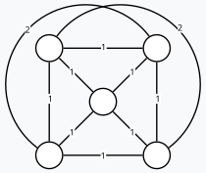
Christofides’ Example
Start with a Graph

Slide 16
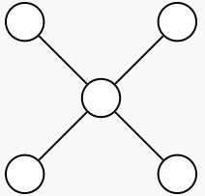
Finding Minimum Spanning Tree

Slide 17
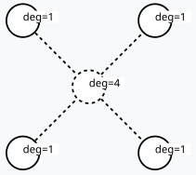
Calculate the set of vertices O with odd degree in T

Slide 18
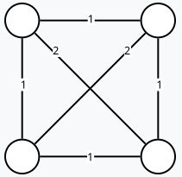
Form the subgraph of G using only the vertices of O

Slide 19

Construct a minimum-weight perfect matching M in this subgraph

Slide 20
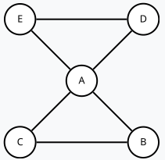
Unite Matching and spanning tree T U M to form a Eulerian multigraph

Slide 21
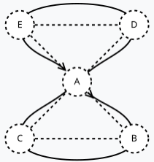
Calculate a Eulerian Cycle
Notes:
A,B,C,A,D,E,A or A,B,C,A,E,D,A.

Slide 22
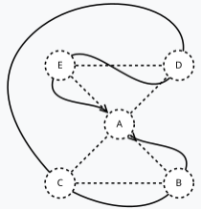
Remove Repeated Vertices

Slide 23
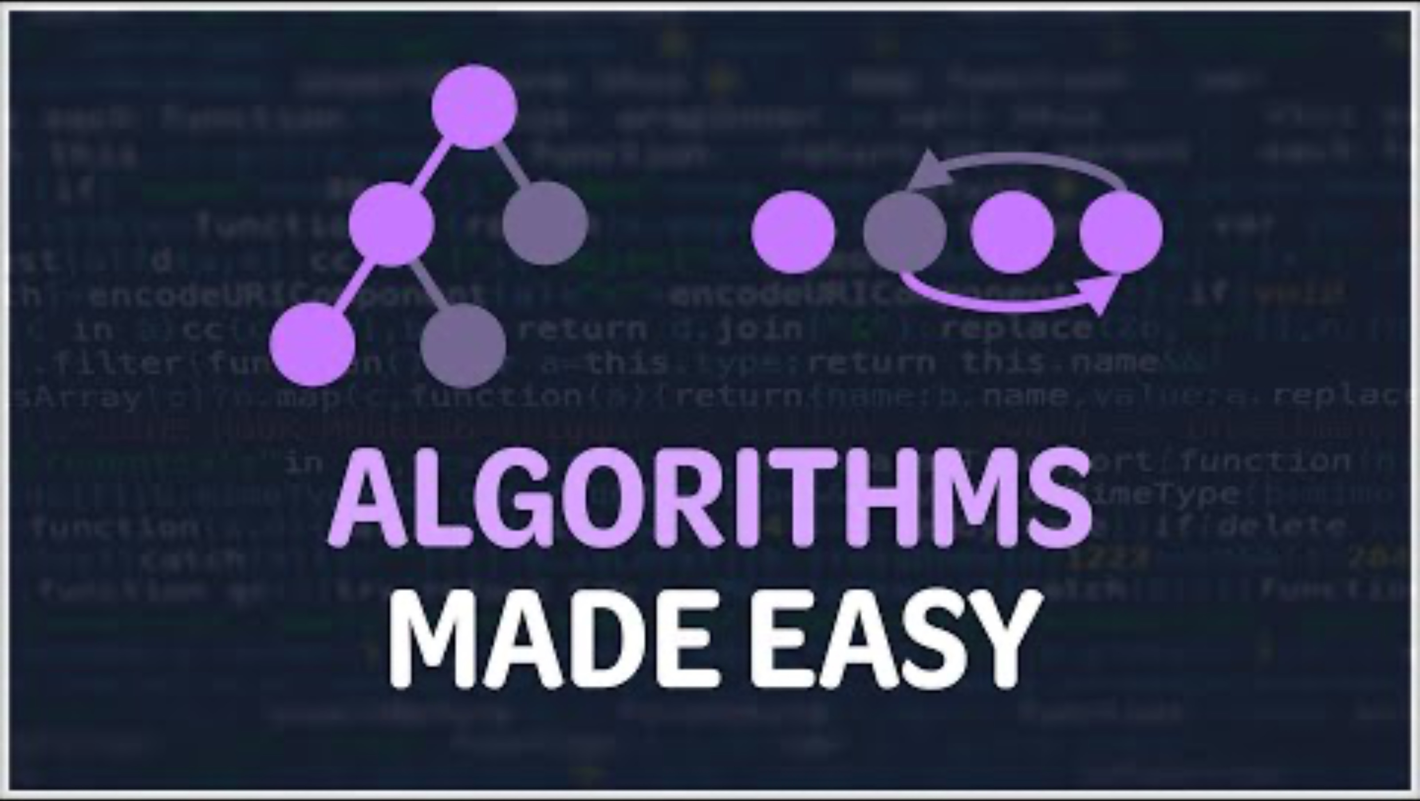
Interview Prep Video
Notes:
https://www.youtube.com/watch?v=kp3fCihUXEg
BONUS video: https://www.youtube.com/watch?v=OTNe0eV8418

Slide 24
Suggested Readings for Further Studies
"Introduction to the Theory of Computation" by Michael Sipser.
"Computers and Intractability: A Guide to the Theory of NP-Completeness" by Michael Garey and David S. Johnson.

